Slide 1


SMARTCITY
Department of Computer Science and Engineering
Submitted by: xyz
Guided by: xyz
Asst. Professor

Slide 2
Contents
1. | Introduction
2. | Problem Statement
3. | Objective
4. | Database
5. | Feasibility Study
6. | DFD
7. | E-R Diagram
8. | User Interface
9. | Conclusion

Slide 3
Introduction
Bhubaneswar tops the list of smart cities, thus no stone should be left unturned to introduce smartness in our lives.
It is the health that is the real wealth and not pieces of gold and silver.
So, as we run towards smartness why should we lack behind compromising the health facilities available in our city.
Giving a boost to the smart concept, we have come up with an initiative to host a wide array of services related to our human health under a single platform.

Slide 4
Problem Statement
Existing System:-
One who needs to consult a doctor for certain treatment has to move from hospital to hospital to check availability of a suitable doctor in a specified timing. And sometimes hospitals do loot people with money.
In case of path labs, we people are least aware about whether a particular test is performed in a specified patho-lab and sometimes we are not prepared with the prices of the tests.
Well The gift of blood is the gift of life. There is no substitute for human blood. Every two seconds someone needs blood. India has an acute shortage of blood and hundreds shed their lives for shortage of blood. Getting blood availability information from various blood banks at the time of need is quite disheartening.
More than 300 blood donations are needed every day for our city. But managing them and distributing blood equally across all blood banks is another challenge.

Slide 5
Problem Statement
Existing System:-
We do have Uber, OLA as our cab service but we don't have any such service to track or use any ambulance to ferry us to hospitals .
Its more pathetic when we require an emergency service like a burn unit or trauma care unit to reach out in minutes. And sometimes long waits do turn fatal.
Several health check up events do take off around the city but to no effect as information regarding those doesn’t reach everyone.
Well another interesting fact comes up, which we don’t face very often but sometimes we do have to. Its in time of someone’s death we require a mortuary van to take the dead for funeral but cabs generally oppose to provide that service. So getting a mortuary van available takes long time.

Slide 6
Problem Statement
Proposed System:-
All services related to health under one platform.
Services providing information based on GPS.
One touch facility to avail ambulance ,hospitals ,path-labs, blood banks,Mortuary vans and a host of emergency services.
A comparative selection of services possible through various filters
A host of related services like blood donation facilities along with information regarding various events like health check up camps, etc.

Slide 7
Objective
This project is motivated by every citizen needs as for availing a health related service, there is not enough information in the internet about any service in particular.
Through this project, all the information is a single click away and helps to choose a better service both in requirement and cost.
Databases necessary for the data management and its entities will be created.
The user interface will be integrated with codes and databases to shape the application.

Slide 8

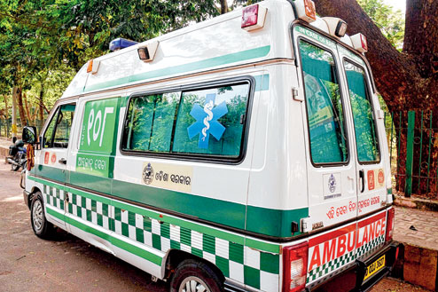


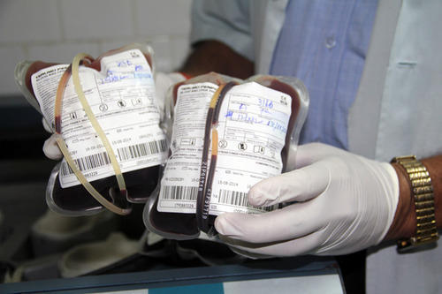
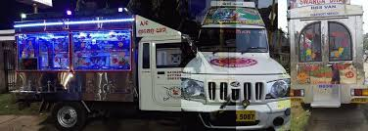
Objective

Slide 9
Database
login | admin | organisation | user
->id(PK) | ->aid(PK,FK) | ->oid(PK) | ->uid
->logname | ->logname | ->name | ->name
->pwd | ->fullname | ->area | ->fname
->type | ->fathername | ->city | ->dob
->status | ->dob | ->dist | ->gender
->secques | ->gender | ->state | ->mstatus
->secans | ->phone | ->phone | ->edu
->photo | ->mail | ->mail | ->phone
->dor | ->cadd | ->timing | ->mail
 | ->padd | ->type | ->cadd
 |  |  | ->padd
 |  |  | ->idprf
 |  |  | ->idprfid
 |  |  | ->dor

Slide 10
Database(contd.)
blood | blddonation | donor | lab
->bldid(PK) | ->did(PK) | ->did(PK,FK) | ->tid(PK)
->oid(FK) | ->oid | ->name | ->oid(FK)
->grp | ->lastdate | ->fname | ->tname
->rhfac | ->futrdate | ->dob | ->fees
->unit | ->status | ->gender | ->days
 |  | ->mstatus
 |  | ->phone
 |  | ->mail
 |  | ->cadd
 |  | ->padd
 |  | ->grp

Slide 11
Database(contd.)
vehicle | booking | dept | doctor
->vid(PK) | ->bookid | ->depid(PK) | ->doid(PK)
->oname | ->vid | ->oid(FK) | ->oid(FK)
->vno | ->bookfrom | ->name | ->depid(FK)
->dname | ->booktill | ->type | ->name
->dno | ->dist | ->timing | ->timing
->timing | ->price |  | ->fee
->price | ->uid |  | ->days
->status | ->status

Slide 12
Feasibility Study
HARDWARE REQUIREMENTS:
Processor : Intel core -2 duo (min).
RAM : 500MB (min).
Hard Disk : 40 GB (min).
SOFTWARE REQUIREMENTS:
Operating System : Windows 7 or higher.
Back End : My Sql 5.1
Validation : JavaScript
Front End : HTML, CSS
Technologies : JDK 1.6,J2EE, JDBC, SERVLETS, JSP
Web Server : Apache Tomcat 7.0
Web Technologies : HTML, JavaScript
Web Browsers : Mozila Firefox,Google Chrome
IDE : Dreamweaver8
Documentation Tool : Microsoft word 2007

Slide 13
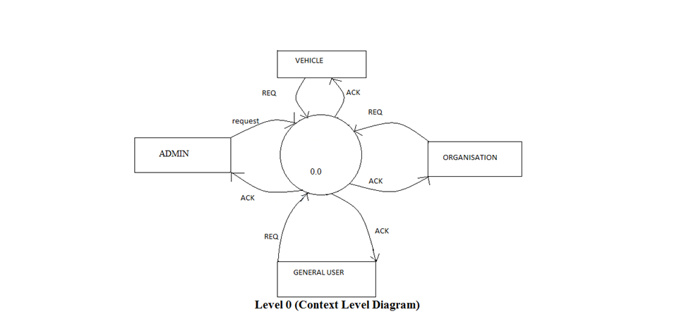
DFD Level-0

Slide 14
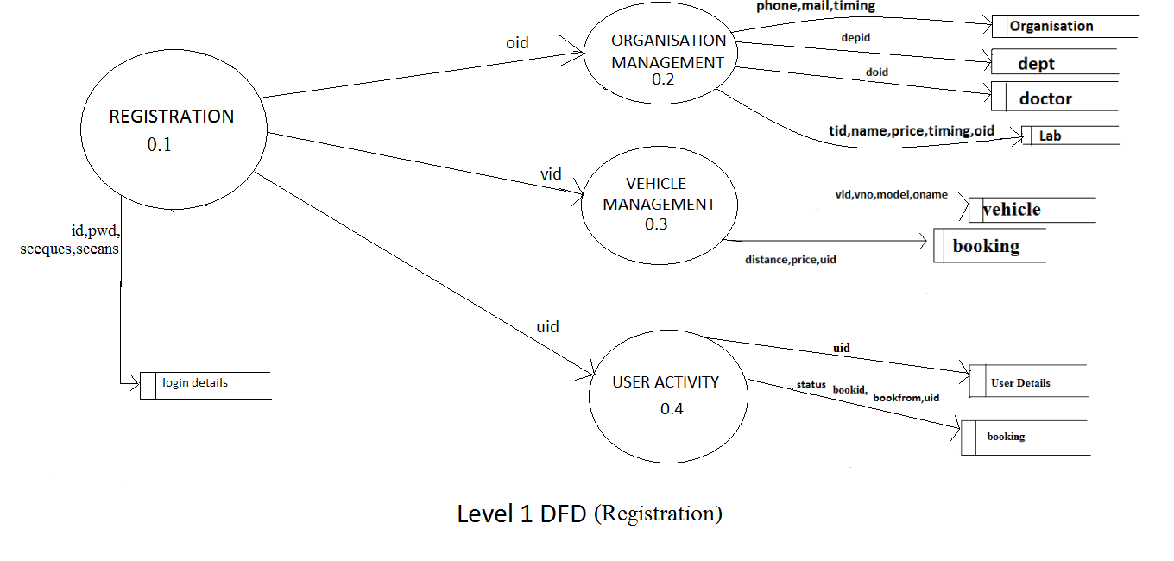
Level-1 DFD

Slide 15
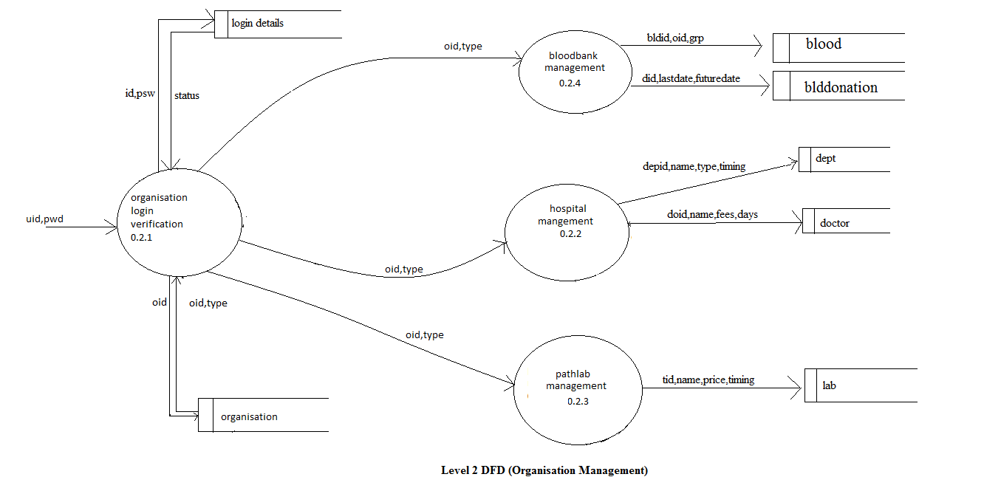
Level-2 DFD (Organisation Management)

Slide 16
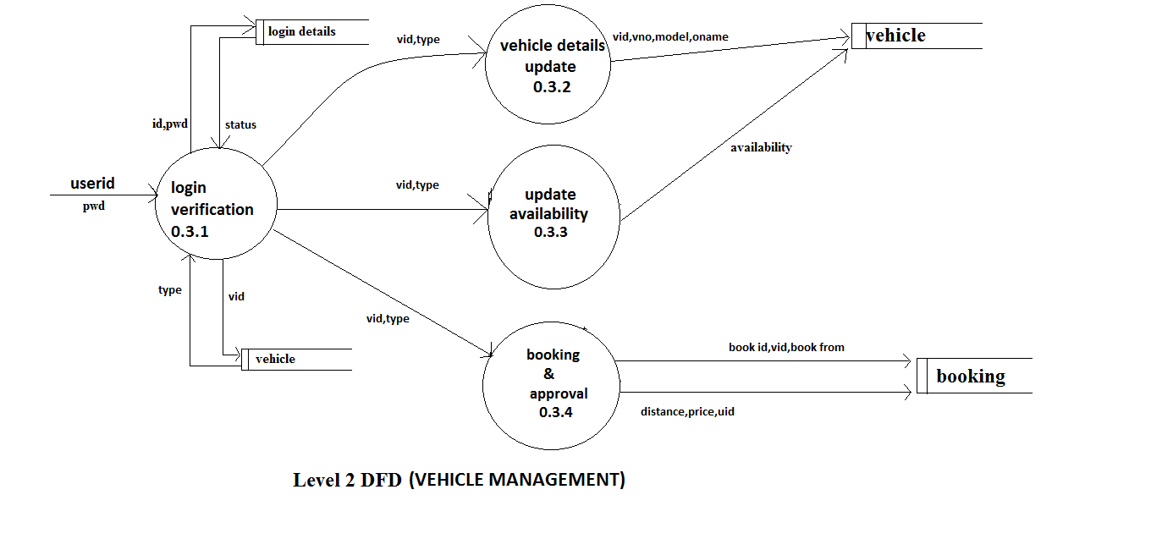
Level-2 DFD(Vehicle Management)

Slide 17
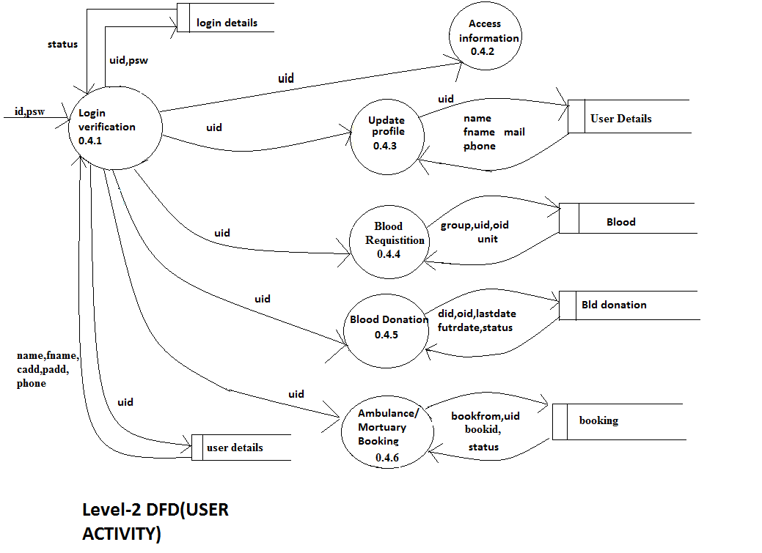
Level-2 DFD(User Activity)

Slide 18
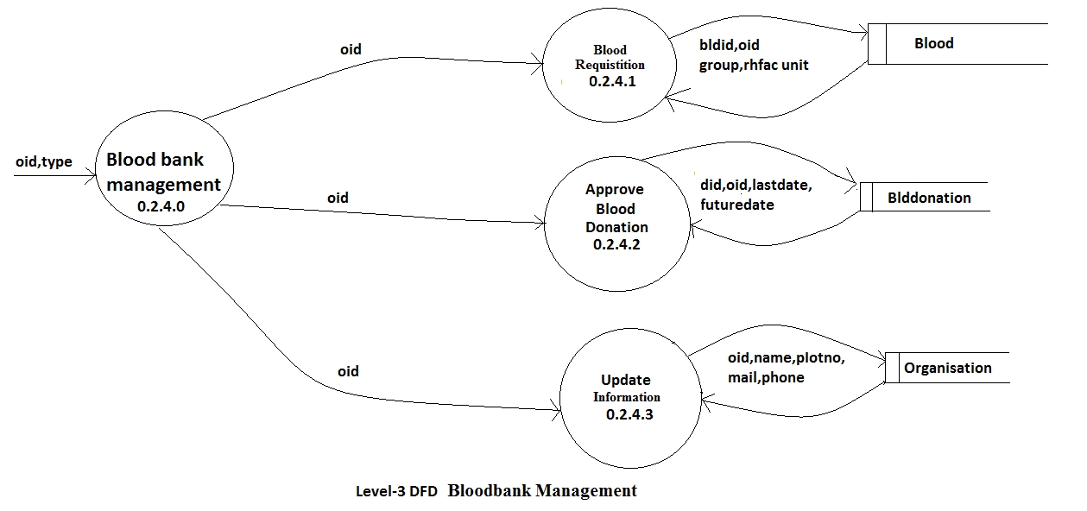
Level-3 DFD(Bloodbank Management)

Slide 19
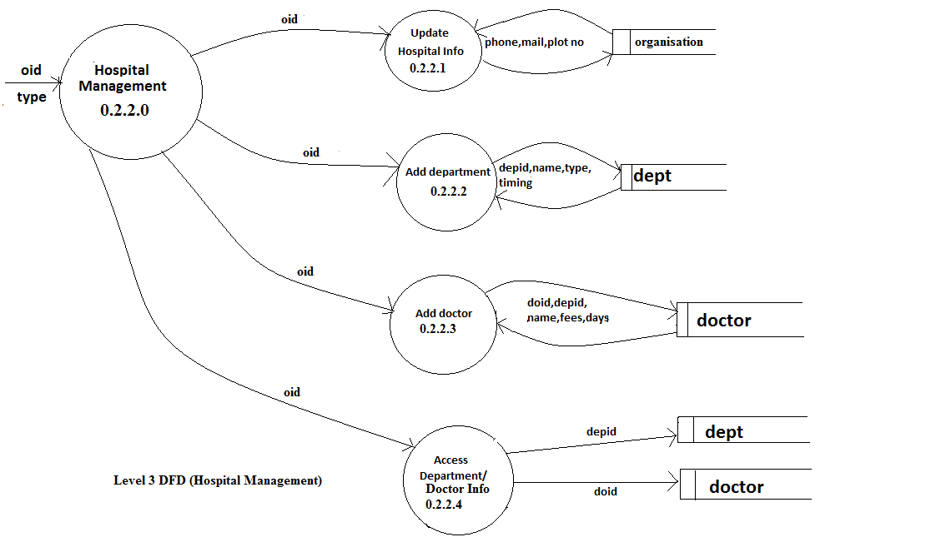
Level-3 DFD(Hospital Management)

Slide 20
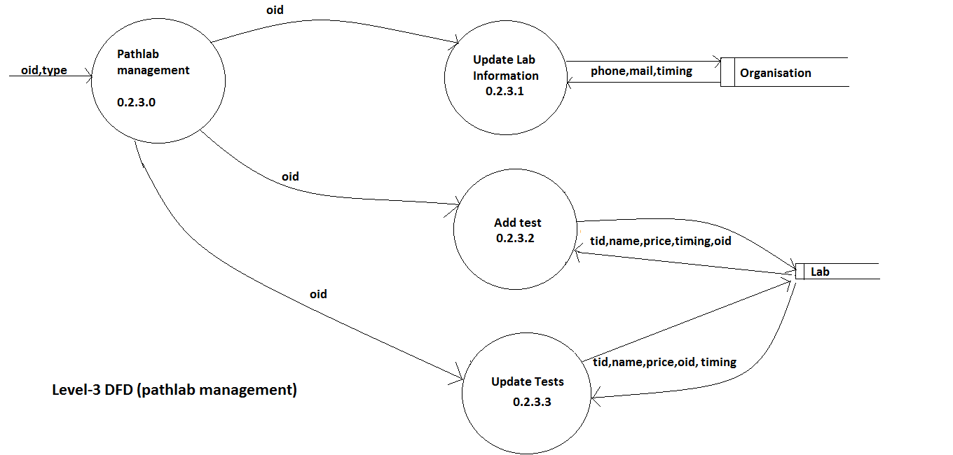
Level-3 DFD(Pathlab Management)

Slide 21
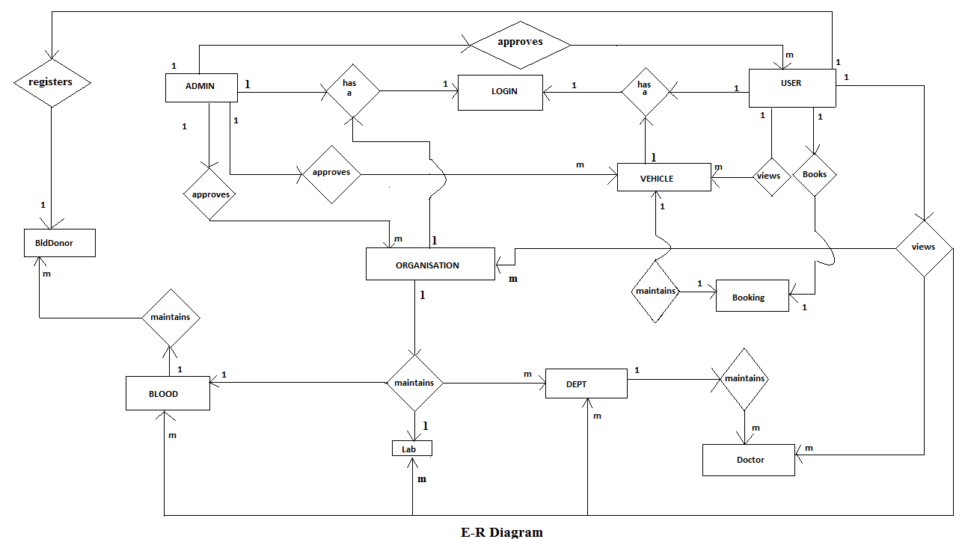
E-R Diagram

Slide 22
User Interface

Slide 23
Registration Page

Slide 24
Conclusion
Smart City people can get a host of health related services at their fingertip after implementation of this application by all organizations. It would keep people updated with the information and would specially keep them aware of the prices charged to them for the services. Organisations can also get a platform through this application to enhance their business. Smart Health is Smart Living which the Smart City Deserves.

Slide 25
Thank You

